Slide 1
Drowsiness Detection System
su
Under the supervision of
Dr. P Praveen( Dr. Sridhar Chintala )
Associate Professor School of
Computer Science & Artificial Intelligence
Presented for
Milestone 3-Final Minor Project Review
Date:26-04-2024
Candidate No. & Name
HTNO. | Name
2103A52024 2103A52096 2103A52093 2103A52119 2103A52031 | M.Ayaz M.Sohail K.Yeshwant Kartik Hirulkar G.Bhavana

Slide 2
Abstract
We present a drowsiness detection system. As we know the drowsy driving is very risky now a days as travelling by roads has became a trend now and in proposed system the machines continuous monitoring the drivers which are making their way towards their destination.

Slide 3
Introduction
Sentiment analysis: Driver drowsiness applies the face recognition system , eye tracking, physcological behaviour, driver drving way are alos monitored while they are going through the camera. By identifying the early chances of the accident this system intervenes to prevent the accident. Offering the vital solution to prevent the drowsiness of the driver or giving them alert.
Public Opinion is almost positive towards this seeing them as a vital tool of the road safety, offering the real time monitoring and intervation to prevent accidentscaused by the driver fatigue.

Slide 4
Literature Review
Drowsiness detection systems have garnered significant attention in recent years due to their potential to mitigate the risks of drowsy driving. Studies by Philip et al. (2019) and Zhang et al. (2020) highlight the effectiveness of multi-sensor approaches, combining facial recognition, eye tracking, and physiological signals for accurate drowsiness detection.
Advancements in computer vision techniques, as demonstrated by Huang et al. (2021), have improved the robustness of facial expression analysis, enabling real-time monitoring of fatigue-related cues such as drooping eyelids and yawning. Similarly, eye-tracking studies by Chen et al. (2018) emphasize the importance of blink patterns and eye closure duration in assessing driver alertness.
Advancements in computer vision techniques, as demonstrated by Huang et al. (2021), have improved the robustness of facial expression analysis, enabling real-time monitoring of fatigue-related cues such as drooping eyelids and yawning. Similarly, eye-tracking studies by Chen et al. (2018) emphasize the impoance of blink patterns and eye closure duration in assessing driver alertness.

Slide 5
Problem Statement :-
Current drowsiness detection systems face challenges such as false alarms, adaptability to diverse conditions, real-time performance issues, user acceptance concerns, and the absence of standardized regulations. Overcoming these hurdles requires interdisciplinary efforts to improve accuracy, user experience, and regulatory frameworks for enhanced road safety.

Slide 6
Solution :-
Innovations in drowsiness detection systems could involve integrating emotion recognition for deeper insights, contextual awareness to consider external factors like traffic, personalized models adapting to individual behaviors, biometric authentication for security, and real-time feedback for proactive interventions. These additions would enhance accuracy, user experience, and overall effectiveness, contributing to safer roadways.

Slide 7
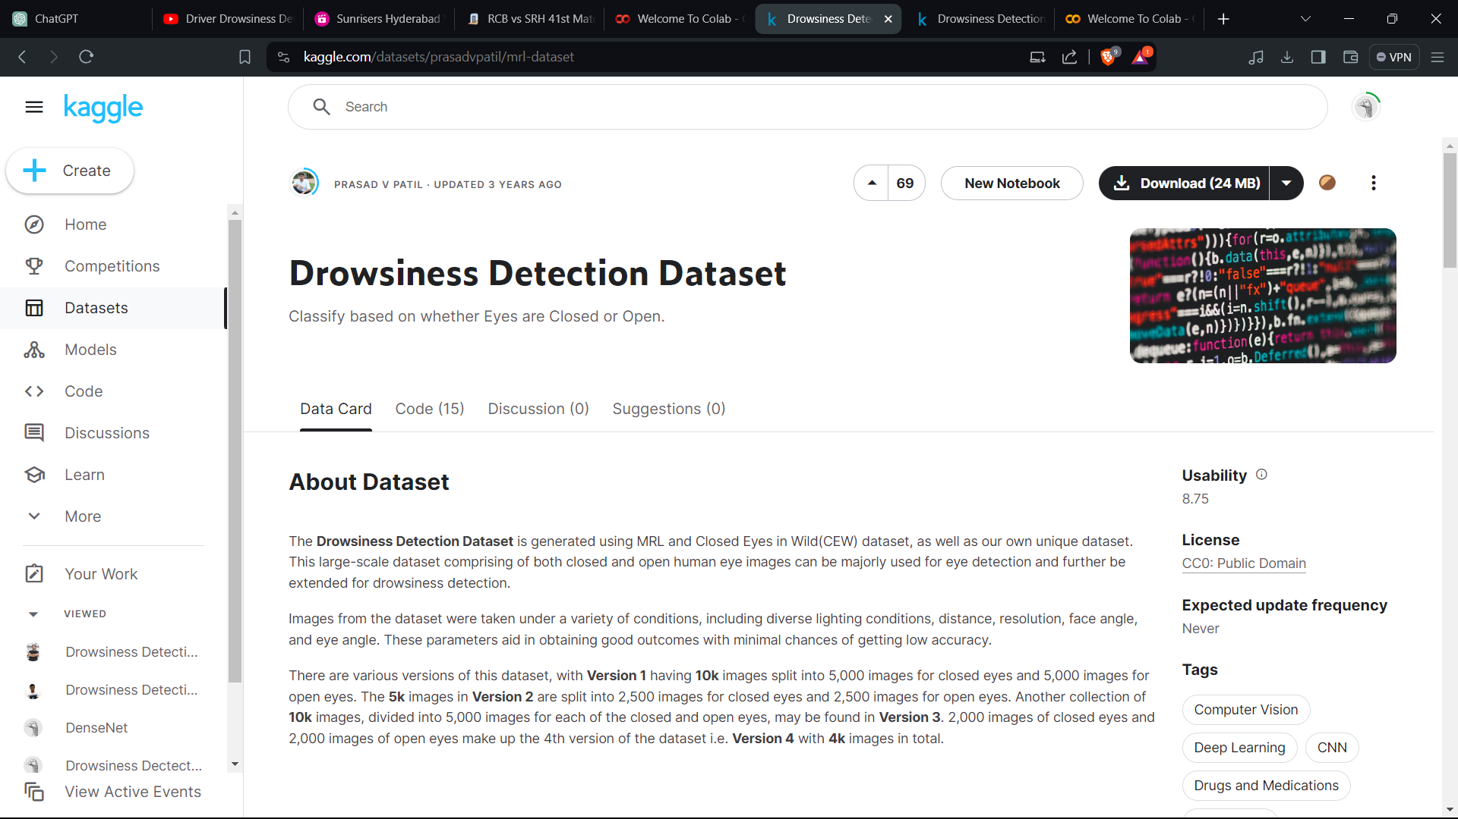
Data Set :-

Slide 8
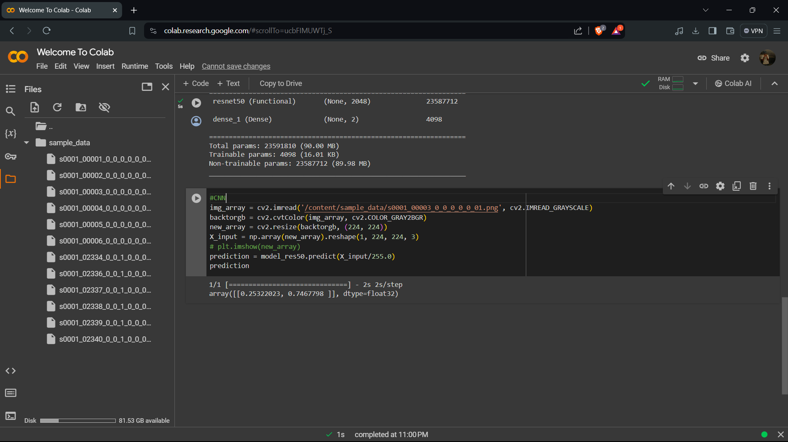

Slide 9
Conclusion :-
Drowsiness detection systems play a crucial role in mitigating the risks of drowsy driving, offering real-time monitoring and interventions to enhance road safety. While current systems face challenges, ongoing advancements in technology and research hold promise for improving their accuracy, adaptability, and user acceptance.

Slide 10
Future Scope :-
Future research could focus on refining drowsiness detection algorithms through advanced machine learning techniques and data fusion methods. Additionally, integrating emerging technologies such as artificial intelligence, Internet of Things (IoT), and wearable devices could further enhance the capabilities of these systems. Moreover, efforts to standardize regulations and promote public awareness are essential to facilitate widespread adoption and maximize the impact of drowsiness detection technology on road safety.

Slide 11
Timeline & Work Plan/ Progress
Jan’24 | Feb’24 | Mar’24 | Apr’24
[ Define project goals and objectives - Gathering and preprocessing the dataset - Conducting exploratory data analysis | Evaluating the performance of the models using appropriate metrics | - Preparing for the final presentation or report
Study of Literature
Building the Model
Training &Testing
Report Preparation
Project report preparation

Slide 12
Refrences :-
Chaerani, N. (2018). Peran International Labour Organization Terhadap Peningkatan Lingkungan Kerja Di Sektor Industri Garmen Di Bangladesh.
Universitas Hasanuddin, 151(2), 10–17.M Saiful Islam, Rakib, M. A., & Adnan, A. (2019).
Ready-Made Garments Sector of Bangladesh: Its Growth, Contribution, and Challenges. Economics World, 7(1). https://doi.org/10.17265/2328- 7144/2019.01.004Mahesh, Batta. 2019.
Machine Learning Algorithms - A Review DOI: 10.21275/ART20203995Mubarok, N. (2017).
Strategi Pemasaran Islami Dalam Meningkatkan Penjualan Pada Butik Calista. I-Economics, 3(1), 73–92.Sri, D., & Margareta, C. (2020).

